Slide 1
Senior Registration: Statistics
Curriculum control forms

Slide 2
Programmes
The following programmes are offered by the Subject Group Statistics:
Statistics and Mathematics (2FG H02)
Computer Science and Statistics (2FF H26)

Slide 3
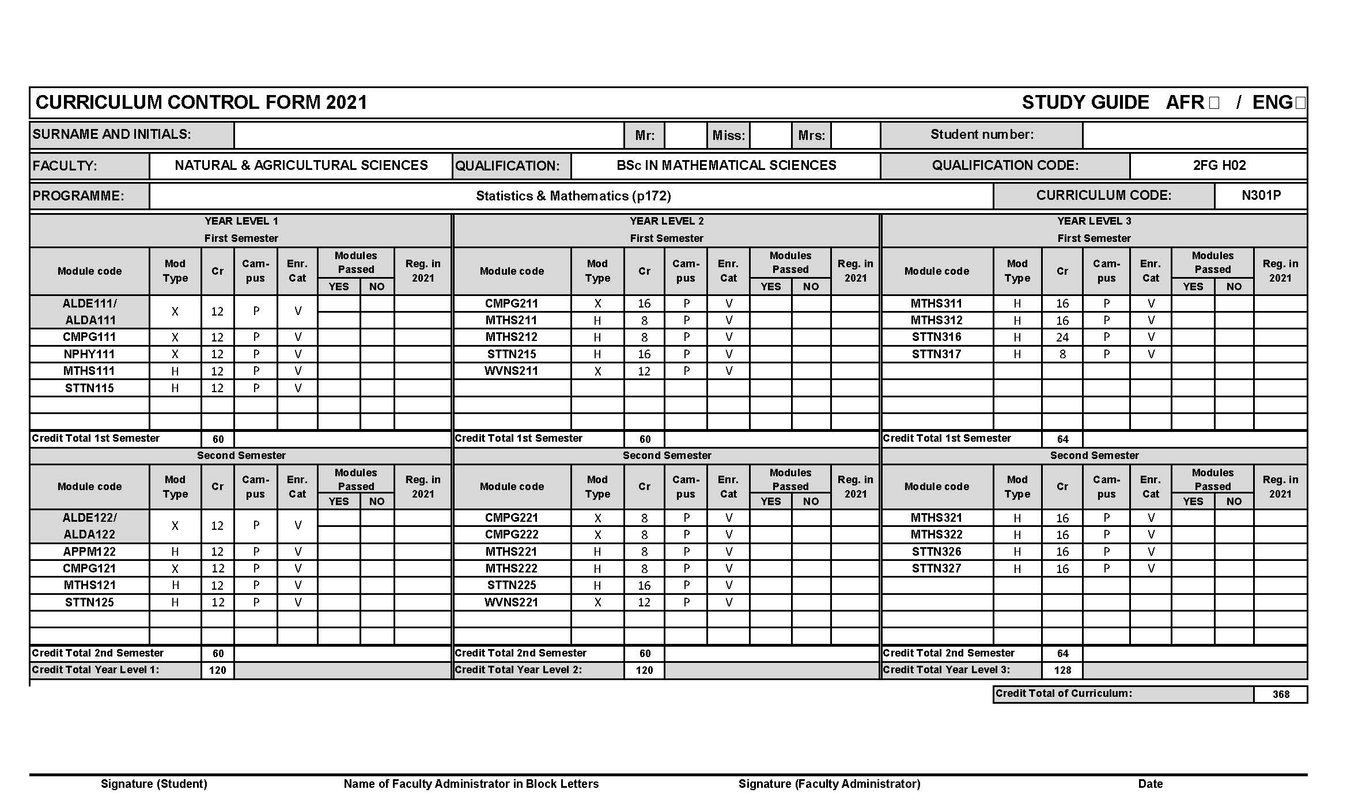
Statistics and Mathematics (2FG H02)

Slide 4
Further assistance (Statistics and Mathematics)
In case you need assistance with
changes in course of study (different degree),
recognition of substitute modules from previous studies,
please contact one of the following persons for advice:
Gerrit Grobler
Subject Advisor (Statistics)
Gerrit.Grobler@nwu.ac.za
Charl Pretorius
Subject Chair (Statistics)
Charl.Pretorius@nwu.ac.za
Dawie Janse van Rensburg
Subject Chair (Mathematics)
Dawie.JanseVanRensburg@nwu.ac.za
For help with administrative issues and to obtain the necessary forms, please contact:
Adelle Jerling
FNAS Undergraduate Administrator
Adelle.Jerling@nwu.ac.za
018 285 2761
Jeanne-Marie Coetzee
FNAS Administration Assistant
20536577@nwu.ac.za
018 299 2458

Slide 5
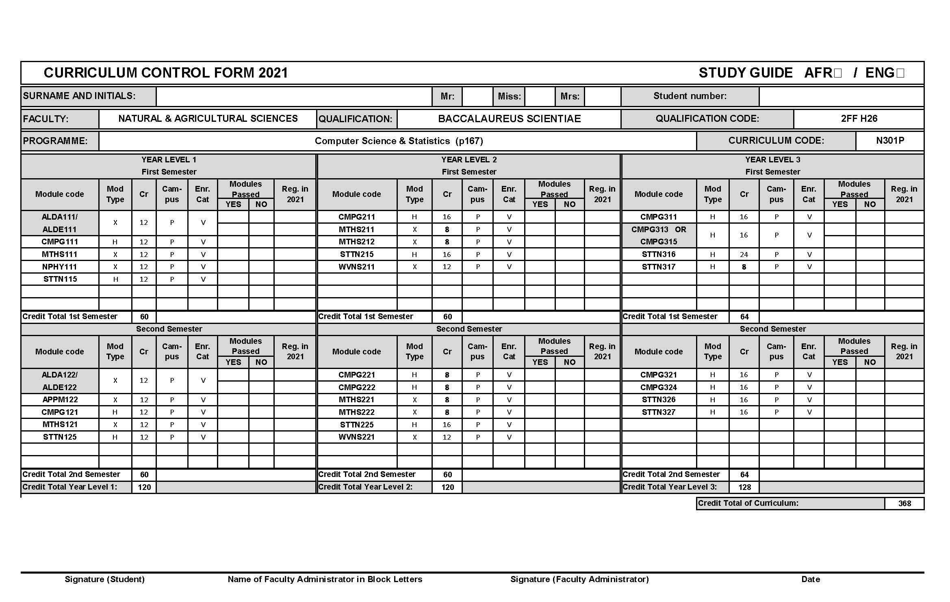
Computer Science and Statistics (2FF H26)

Slide 6
Further assistance (Computer Science and Statistics)
In case you need assistance with
changes in course of study (different degree),
recognition of substitute modules from previous studies,
please contact one of the following persons for advice:
Gerrit Grobler
Subject Advisor (Statistics)
Gerrit.Grobler@nwu.ac.za
Charl Pretorius
Subject Chair (Statistics)
Charl.Pretorius@nwu.ac.za
Lynette Drevin
Subject Chair (Computer Science)
Lynette.Drevin@nwu.ac.za
For help with administrative issues and to obtain the necessary forms, please contact:
Adelle Jerling
FNAS Undergraduate Administrator
Adelle.Jerling@nwu.ac.za
018 285 2761
Jeanne-Marie Coetzee
FNAS Administration Assistant
20536577@nwu.ac.za
018 299 2458

Slide 7
STTN316/7 prerequisites not met
STTN225 is a prerequisite for STTN316 and STTN317, i.e. you need to pass STTN225 before being allowed to continue with STTN316/7.
In 2021 only, students who failed STTN225 but obtained a final module mark of at least at least 40% for STTN225, may register for:
STTN316
STTN317
STTN326
STTN327
Students who failed STTN225 but obtained at least 40%, need to complete a “student request form” to be able to register for the third-year modules. Student request forms are available from:
Students who failed STTN225 in 2020 still need to repeat the module in 2021, regardless of the final module mark.
Adelle Jerling
FNAS Undergraduate Administrator
Adelle.Jerling@nwu.ac.za
018 285 2761
Jeanne-Marie Coetzee
FNAS Administration Assistant
20536577@nwu.ac.za
018 299 2458

